Slide 1

Varendra University
Presented by-
Sadia Islam
Id- 251311026
Section- A
2nd Semester
36th Batch
Varendra University, Rajshahi
Presented to-
Sanjoy Kumar Chakravarti
Lecturer

Slide 2

Example of conversion from English sentence to Logical expression and vice versa

Slide 3

What are Logical Expressions?
Logical expressions are formal representations of statements, arguments, and ideas using symbols and rules. They allow for precise and unambiguous communication, especially in fields like mathematics, computer science, and philosophy.
1
2
Clarity
Precision
Eliminate ambiguity inherent in natural language.
Represent exact meanings without misinterpretation.
3
Analysis
Facilitate rigorous examination of arguments.

Slide 4
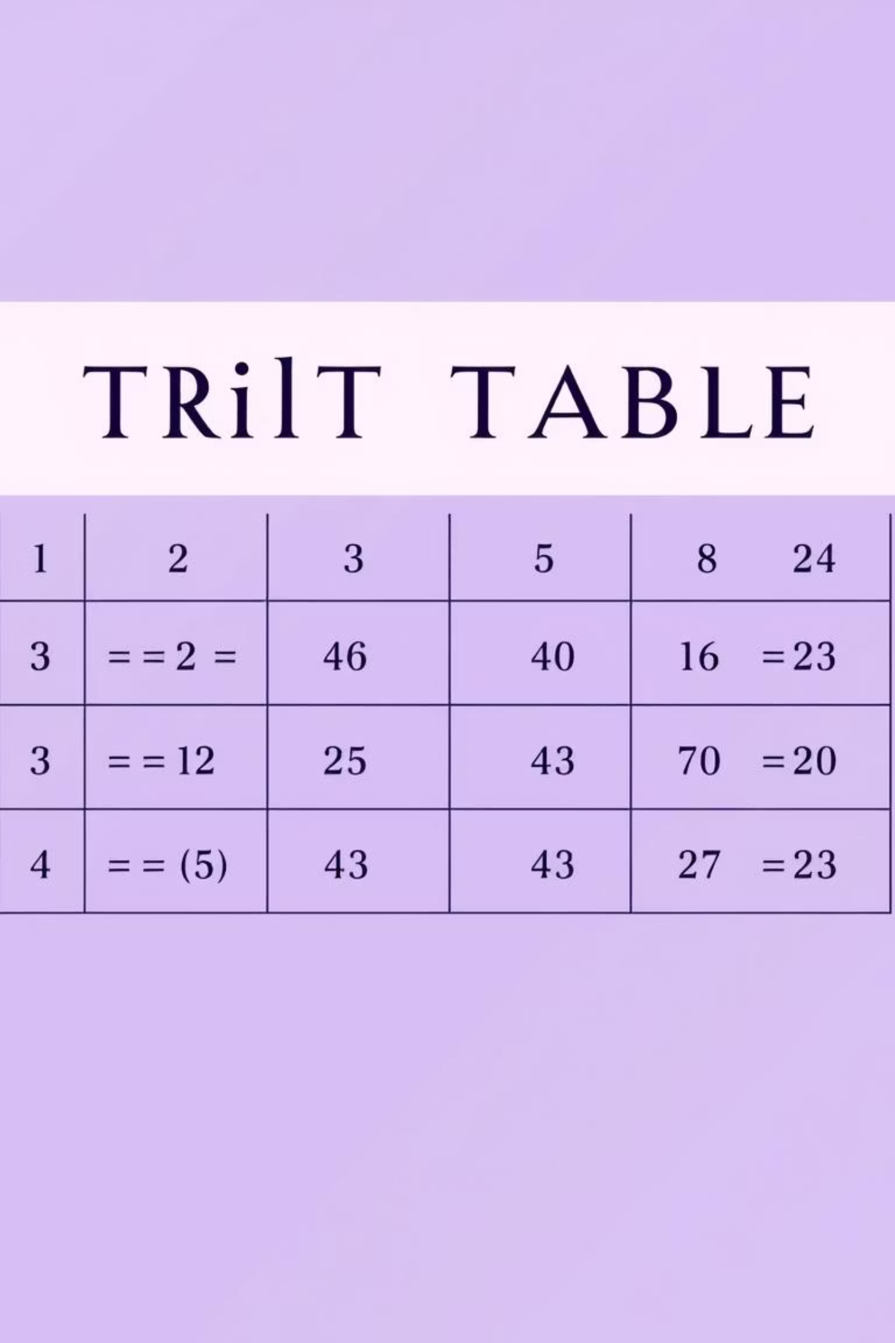

Core Symbols of Propositional Logic
Propositional logic uses specific symbols to represent logical connectives,
forming the building blocks of more complex expressions.
Conjunction (AND)
Symbol: ∧Represents "and". Both statements must be true.
Disjunction (OR)
Symbol: ∨Represents "or". At least one statement must be true.
Negation (NOT)
Symbol: ¬Represents "not". Reverses the truth value.
Implication (IF...THEN)
Symbol: →Represents "if...then".

Slide 5

Translating English to Logic: The Process
Converting English sentences into logical expressions involves identifying propositions, assign variables, and applying the correct logical connectives.
01
Identify Propositions
Break down the sentence into simple, declarative statements.
02
Assign Variables
Represent each proposition with a unique letter (e.g., P, Q, R).
03
Map Connectives
Translate words like "and," "or," "not," "if...then" to their logical symbols.
04
Construct Expression
Combine variables and symbols to form the complete logical expression.

Slide 6

Example: English to Logical Expression
Let's walk through an example to solidify our
understanding of the conversion process.
English Sentence:
Logical Breakdown:
"If it rains and I don't have an umbrella,
then I will get wet."
P: "It rains"
Q: "I have an umbrella"
R: "I will get wet"
Logical Expression:
(P ∧ ¬Q) → R
This expression clearly shows the conditional relationship
between the statements.

Slide 7


Translating Logic to English: The Reverse Process
The ability to translate logical expressions back into natural language is equally important for interpreting formal arguments and conclusions.
Formulate Sentence
Decode Connectives
Construct a grammatically correct and coherent English sentence.
Identify Variables
Translate logical symbols (∧, ∨, ¬, →) back into their English equivalents.
Recall or define what each propositional variable represents.

Slide 8

Example: Logical Expression to English
English Sentence:
Let's convert a logical expression back into an
understandablecEnglish sentence.
"If it is not the case that the door is open or the
light is on, then the room is dark."
A more natural phrasing might be: "If neither the door is open nor the
light is on, then the room is dark."
Logical Expression:
¬(P ∨ Q) → R
Given the following definitions:
P: "The door is open"
Q: "The light is on"
R: "The room is dark"

Slide 9



Where are Logical Expressions Used?
The application of logical expressions extends across various disciplines, proving their versatility and fundamental importance.
Computer Science
Law & Philosophy
Mathematics & Engineering
Designing algorithms, artificial intelligence, and database queries.
Analyzing legal arguments, ethical dilemmas, and philosophical proofs.
Proving theorems, designing circuits, and solving complex problems.

Slide 10


Real-Life Application: Decision Making
Logical expressions help structure decision-making processes, from simple daily choices to complex business strategies.
Scenario:
How it Helps:
"I will go to the park if it is sunny and I have free time, or if my friend invites me."
Clarifies conditions for action.
Ensures all possibilities are considered.
Logical Representation:
Facilitates automation in rule-based systems.
S: "It is sunny"
T: "I have free time"
F: "My friend invites me"
P: "I will go to the park"
(S ∧ T) ∨ F → P

Slide 11
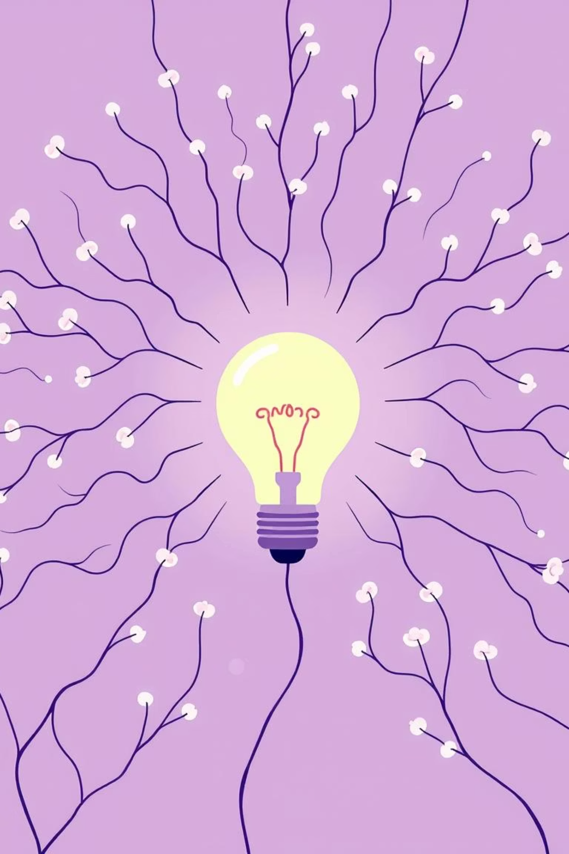
Conclusion: The Power of Formal Logic
Mastering the conversion between English and logical expressions enhances critical thinking and problem-solving skills, providing a robust framework for clear reasoning.
Enhanced Clarity
Rigor in Analysis
Reduces ambiguity in communication.
Allows for precise evaluation of arguments.
Foundational Skill
Essential for various academic and professional fields.
Continue practicing these translations to build your proficiency in formal logic!

Slide 12
Have you any Question?
Thank you

